Slide 1


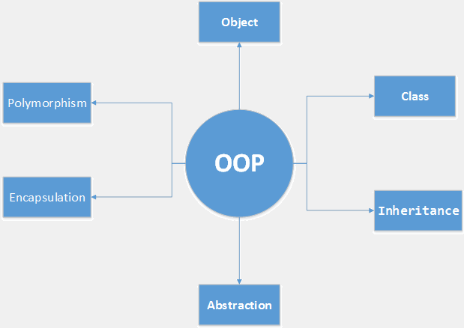

OOP Course - Virtual Trip
Second View to OOP course
Java OOP
SoftUni Team
Ventsislav Ivanov
Software University
http://softuni.bg

Slide 2



Table of Contents
Interfaces & Abstraction
Generics
Exam Overview

Slide 3
Have a Question?
sli.do #Java-OOP

Slide 4
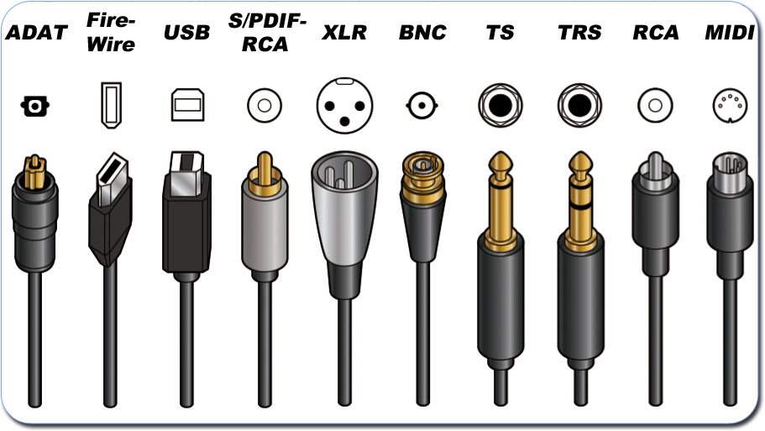
Abstraction
Interfaces

Slide 5

Abstraction in OOP
Abstraction means ignoring irrelevant features, properties, or functions and emphasizing the relevant ones ...
... relevant to the project we develop
Abstraction helps managing complexity
"Relevant" to what?
Notes:
Abstraction means ignoring irrelevant features, properties, or functions and emphasizing the relevant ones, relevant to the project we develop.
Abstraction helps managing complexity
Abstraction is something we do every day:
Looking at an object, we see those things that have meaning to us and ignore all others.
Represent a complex reality with a simplified model.
In a bank application, customers have:
name, phone and address, but they don’t have :
hair color and favorite drink, which we are disregarded from.

Slide 6
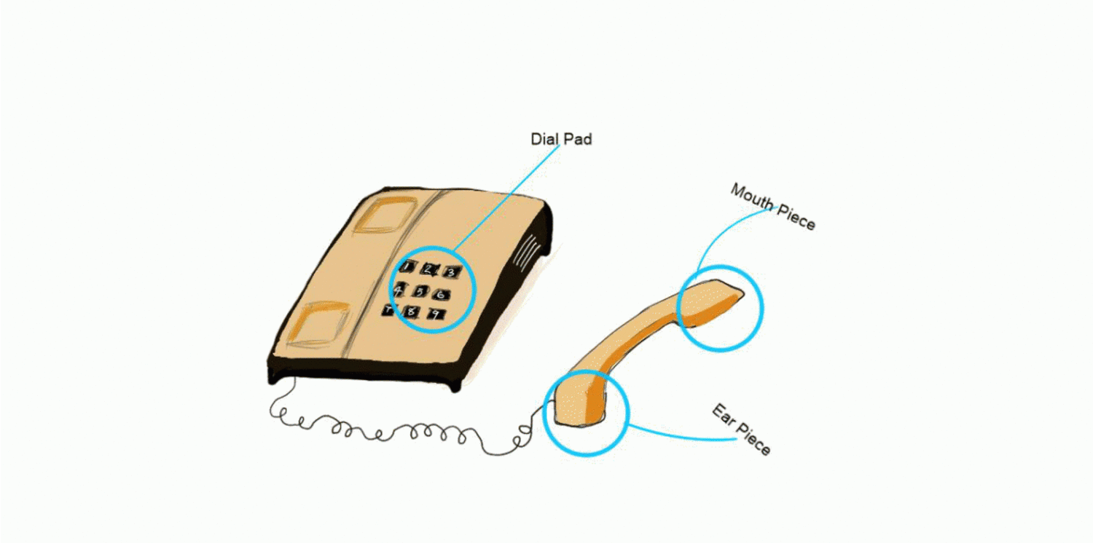
Abstraction Example
Abstraction lets you focus on what the object does instead of how it does it.
Notes:
Abstraction means ignoring irrelevant features, properties, or functions and emphasizing the relevant ones, relevant to the project we develop.
Abstraction helps managing complexity
Abstraction is something we do every day:
Looking at an object, we see those things that have meaning to us and ignore all others.
Represent a complex reality with a simplified model.
In a bank application, customers have:
name, phone and address, but they don’t have :
hair color and favorite drink, which we are disregarded from.

Slide 7
Interface
Internal addition by compiler
public interface Printable {
int MIN = 5;
void print();
}
compiler
interface Printable {
public static final int MIN = 5;
public abstract void print();
}
Notes:
There are two ways to achieve abstraction
- Using Abstract Classes
- Using Interfaces

Slide 8
Iterator<E> vs Enumeration<E>
Both Iterator and Enumeration allows you to traverse over elements of Collections
Iterator takes the place of Enumeration in the Java collections framework.
Iterator | Enumeration
hasNext() | hasMoreElement()
next() | nextElement()
remove()
Notes:
There are two ways to achieve abstraction
- Using Abstract Classes
- Using Interfaces

Slide 9
Comparator <E> vs Comparable <E>
Comparator provides a way for you to provide custom comparison logic for types that you have no control over.
Comparable allows you to specify how objects that you are implementing get compared.
Comparable | Comparator
single sorting sequence | multiple sorting sequence
affects the original class | doesn't affect the original class
compareTo() method | compare() method
Notes:
There are two ways to achieve abstraction
- Using Abstract Classes
- Using Interfaces

Slide 10
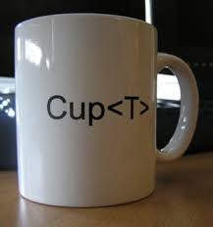
Generics

Slide 11

Generics Classes
Type variable T, that can be used anywhere inside the class
This same technique can be applied to create generic interfaces.
public class Box<T> {
// T stands for "Type"
private T t;
public void set(T t) { this.t = t; }
public T get() { return t; }
}
Notes:
There are two ways to achieve abstraction
- Using Abstract Classes
- Using Interfaces

Slide 12
Generics Method
Type variable T, that can be used anywhere inside the method
T can be returned type too
public static <E> void printArray(E[] inputArray) {
// Display array elements
for (E element : inputArray) {
System.out.printf("%s ", element);
}
System.out.println();
}
Notes:
There are two ways to achieve abstraction
- Using Abstract Classes
- Using Interfaces

Slide 13
Enums
Special data type that enables for a variable to be a set of predefined constants
This same technique can be applied to create generic interfaces.
public enum Level {
HIGH,
MEDIUM,
LOW
}
Level level = Level.MEDIUM
switch (level) {
case HIGH : ...; break;
case MEDIUM : ...; break;
case LOW : ...; break;
}
Notes:
There are two ways to achieve abstraction
- Using Abstract Classes
- Using Interfaces

Slide 14

Annotations
Form of metadata, provide data about a program that is not part of the program itself
Information for the compiler
Compile-time and deployment-time processing
Runtime processing
@Override
void mySuperMethod() { ... }
@interface ClassPreamble {
String author();
String date();
int curRevision() default 1;
String[] reviewers();
}
Notes:
There are two ways to achieve abstraction
- Using Abstract Classes
- Using Interfaces

Slide 15



Reflection

Slide 16
Reflection
Can inspect Java classes at runtime
Inspecting classes is often the first thing you do when using Reflection
You can get class name in two versions
Class myObjectClass = MyObject.class
String className = aClass.getName();
String simpleClassName = aClass.getSimpleName();

Slide 17
Reflection (2)
You can reach almost everything in class
int modifiers = aClass.getModifiers();
Package package = aClass.getPackage();
Class superclass = aClass.getSuperclass();
Class[] interfaces = aClass.getInterfaces();
Constructor[] constructors = aClass.getConstructors();
Method[] method = aClass.getMethods();
Field[] method = aClass.getFields();
Annotation[] annotations = aClass.getAnnotations();

Slide 18
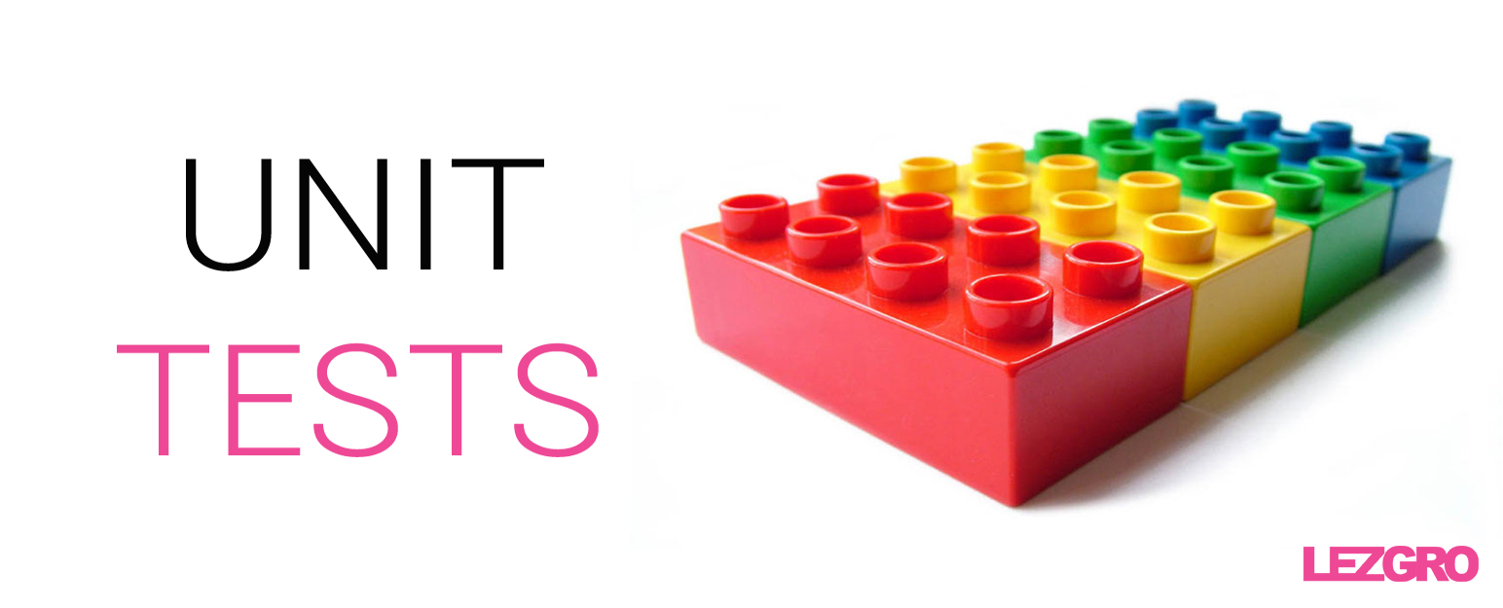
Unit Testing
Developer Job

Slide 19
Unit Testing
Testing technique using which individual modules are tested to determine if there are any issues by the developer himself
The main aim is to isolate each unit of the system to identify, analyze and fix the defects
MyClass tester = new MyClass(); // MyClass is tested
assertEquals("10 x 0 must be 0", 0, tester.multiply(10, 0));
assertEquals("0 x 10 must be 0", 0, tester.multiply(0, 10));
assertEquals("0 x 0 must be 0", 0, tester.multiply(0, 0));

Slide 20
Unit Testing (2)
Reduces Defects in the Newly developed features or reduces bugs when changing the existing functionality.
Reduces Cost of Testing as defects are captured in very early phase.
Improves design and allows better refactoring of code.
Unit Tests, when integrated with build gives the quality of the build as well.
Unit Tests

Slide 21
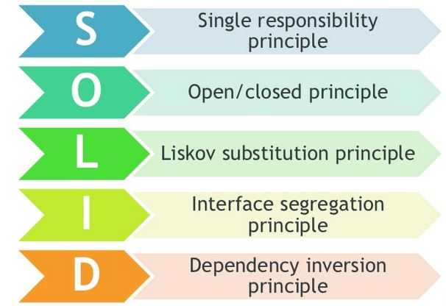
SOLID Principles

Slide 22
SOLID
Single responsibility principle
Class should have only a single responsibility
Open/closed principle
“software entities … should be open for extension, but closed for modification.”
Liskov substitution principle
Objects in a program should be replaceable with instances of their subtypes without altering the correctness of that program.

Slide 23


SOLID
Interface segregation principle
Many client-specific interfaces are better than one general-purpose interface
Dependency inversion principle
"depend upon abstractions, NOT concretions"

Slide 24









Objects and Associative Arrays
https://softuni.bg/courses/javascript-fundamentals

Slide 25
License
This course (slides, examples, demos, videos, homework, etc.) is licensed under the "Creative Commons Attribution-NonCommercial-ShareAlike 4.0 International" license

Slide 26






Free Trainings @ Software University
Software University Foundation – softuni.org
Software University – High-Quality Education, Profession and Job for Software Developers
softuni.bg
Software University @ Facebook
facebook.com/SoftwareUniversity
Software University @ YouTube
youtube.com/SoftwareUniversity
Software University Forums – forum.softuni.bg

